Slide 1
Power Monitoring project
Internet of Things (LTAT.06.020)
Tarlan, Akshin, Minnie

Slide 2



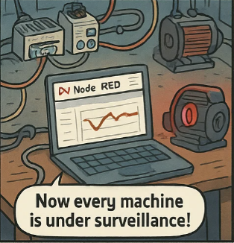


User story - The Truth Behind the Power Bill Killer

Slide 3

Project Overview
Platform: ESP32 + Kancony 868-M16-V2
Developed with PlatformIO
RMS algorithm used to calculate current (I)
Power calculated using:
Transmits data via MQTT
Visualized in Node-RED dashboard

Slide 4
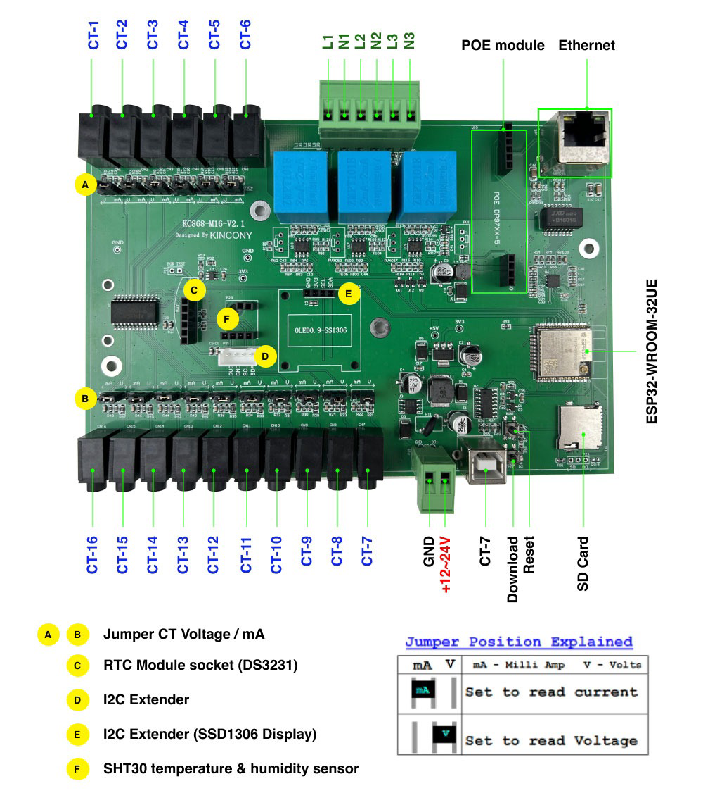
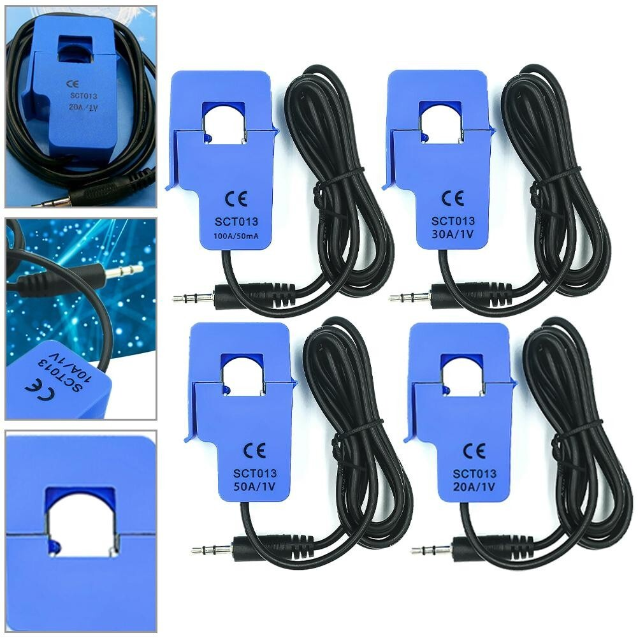
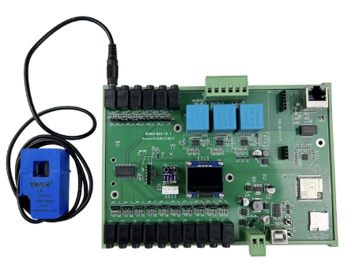
Hardware Setup
Kancony 868- M16-V2 current sensor board
Analog input (ADC GPIO 35)
Measures up to 16 machines via multiplexing

